Slide 2

…And the Regulator Clapped
New Approaches to Maximizing Worker Engagement in Process Safety Management
Chris Robinson
chris.robinson@nebulasafety.com
Subject Matter Expert
www.nebulasafety.com

Slide 3
Agenda
Defining Process Safety Management
Establishing a Worker-Centric PSM Framework
Super-Charging the Sharing
The Day the Regulator Clapped
Improving Process Safety Management Performance

Slide 4
Defining Process Safety Management
Your definition of Process Safety Management
How you manage process safety
Your process safety performance

Slide 5
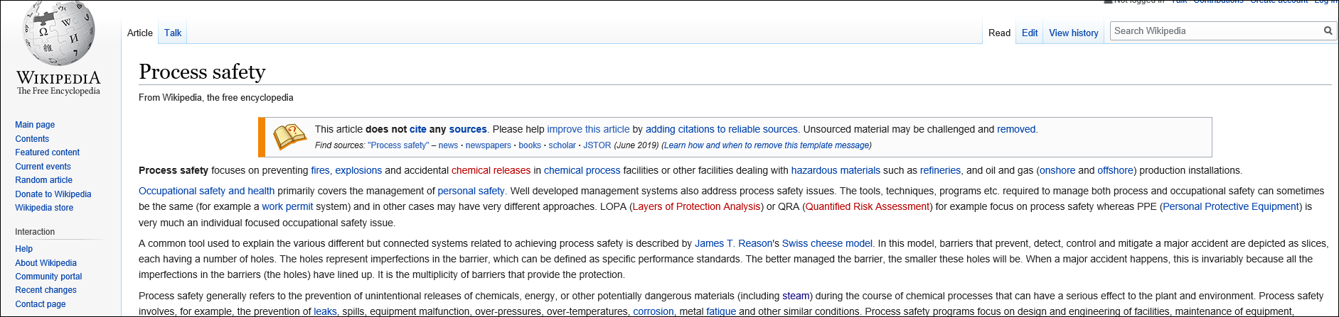
What is Process Safety?
Link

Slide 6
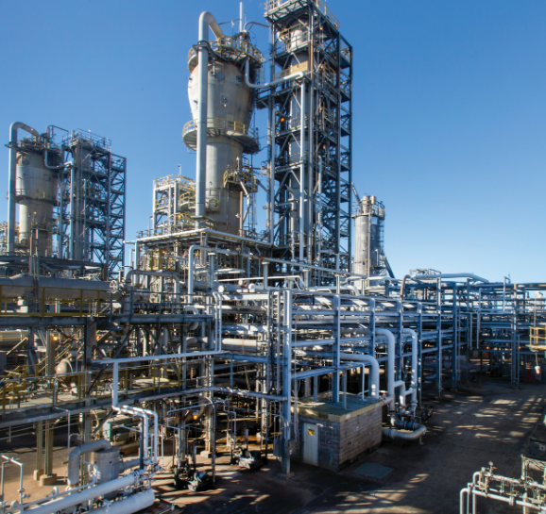
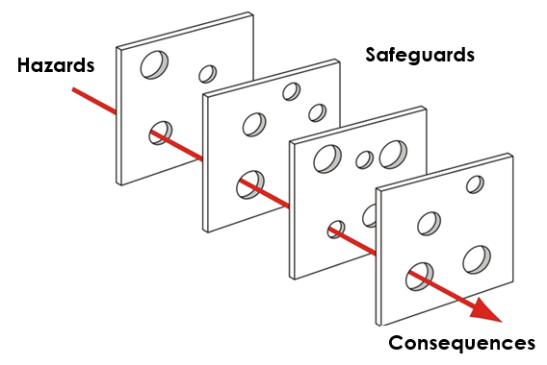

What is Process Safety?
Link

Slide 7
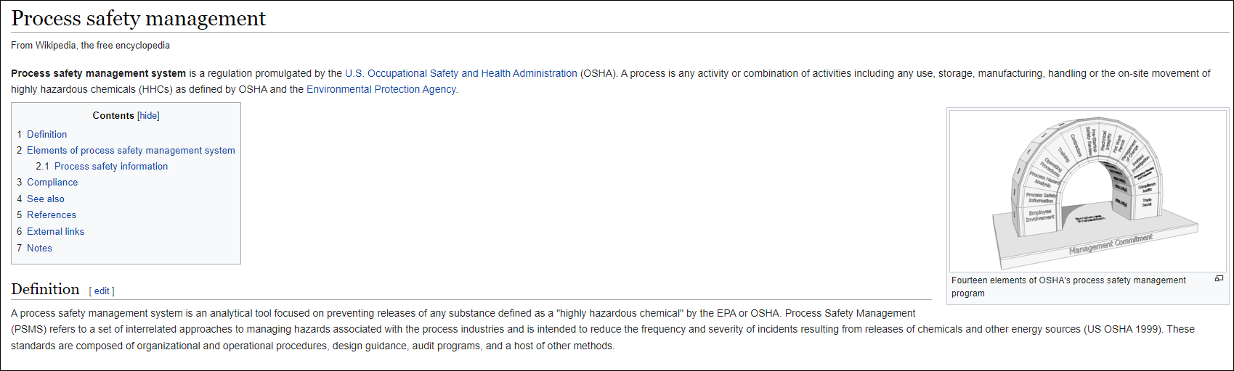
What is Process Safety Management?
Link

Slide 8

What is Process Safety Management?
Link

Slide 9
Establishing a Worker-Centric PSM Framework
A worker-centric PSM Framework
Improved worker engagement in PSM activities
Improved process safety performance

Slide 10
Can We Also Manage Process Safety With Cheese?
Fourteen (14) OSHA Elements of PSM
Employee Participation
Process Safety Information
Process Hazard Analysis (PHA)
Operating Procedures
Training
Contractors
Pre-Startup Safety Review (PSSR)
Mechanical Integrity
Hot Work Permit
Management of Change (MOC)
Incident Investigation
Emergency Planning and Response
Compliance Audits
Trade Secrets

Slide 11

What About Other Activities That Improve PSM Performance?
Field Safety Audits
Process Trending
Donning PPE
Field Checks
Learning from Industry Incidents
LOTO (Lock-out/ Tag-out)
Action Item Completion
Risk Assessments
Job Hazard Analysis (JHA)
Stewardship of Disabling Safety Devices
Reliability Assessments
Inspection Data Review
Job Safety Analysis (JSA)
Incident Reporting
Work Permit
Instrument Checks/ Testing
Metrics Review
Alarm Management
Operator Rounds
Design Review
Emergency Notification
Field Verification
Process Evaluation

Slide 12






A Worker-Centric PSM Framework
Operating Procedures
Process Hazard Analysis (PHA)
LOTO (Lock-out/ Tag-out)
Incident Investigation
Process Safety Information (PSI)
Action Item Completion
Leadership Observations
Risk Assessments
Job Hazard Analysis (JHA)
Looking Forward
Instrument Checks/ Testing
Looking Backward
Work Permit
Learning from Industry Incidents
Reliability Assessments
Contractor Management
Preventative Maintenance (PM)
Management of Change (MOC)
Maintenance Procedures
Process Trending
Operator Rounds
Incident Reporting
Alarm Management
Compliance Audits
Donning PPE
Emergency Notification
Field Investigation
Pre-Startup Safety Review (PSSR)
Stewardship of Disabling Safety Devices
Metrics Review
Design Review
Emergency Drills and Planning
Process Evaluation
Inspection Data Review
Job Safety Analysis (JSA)
Training
Field Verification

Slide 13
Super-Charging the Sharing
Improves the sense of vulnerability
Helps with early identification of warning signs and incident precursors
Enhances understanding of how human performance factors contribute to incidents
Provides insight for all levels in the organization
Fosters a culture of learning and improvement

Slide 14
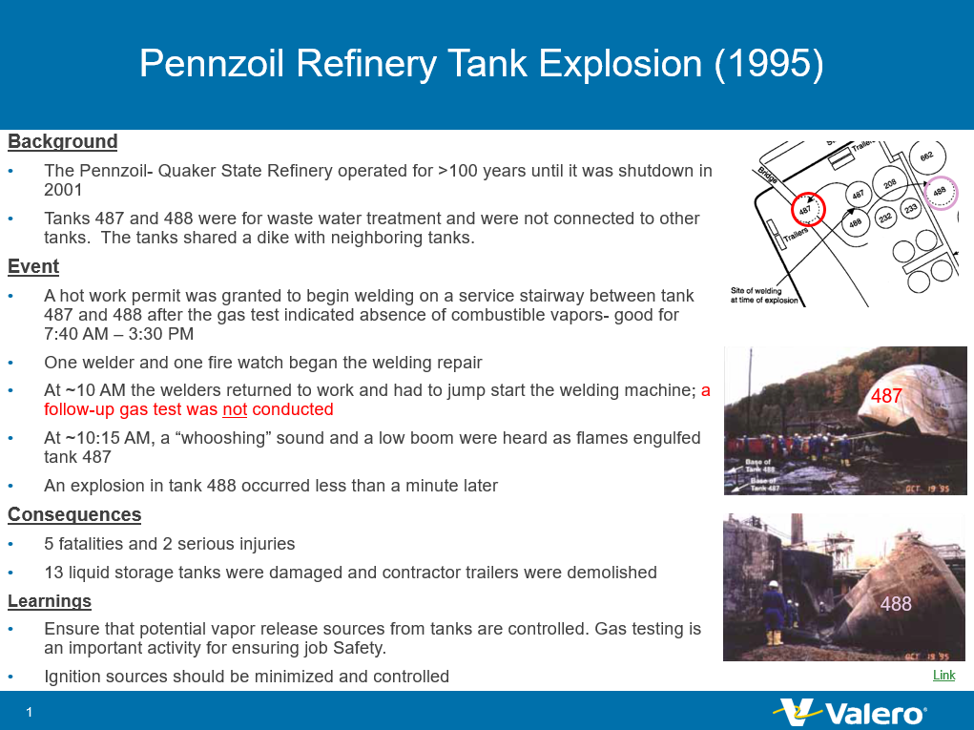
“Throwback Thursday” Example
Pennzoil Refinery Tank Explosion (1995)
Link

Slide 15
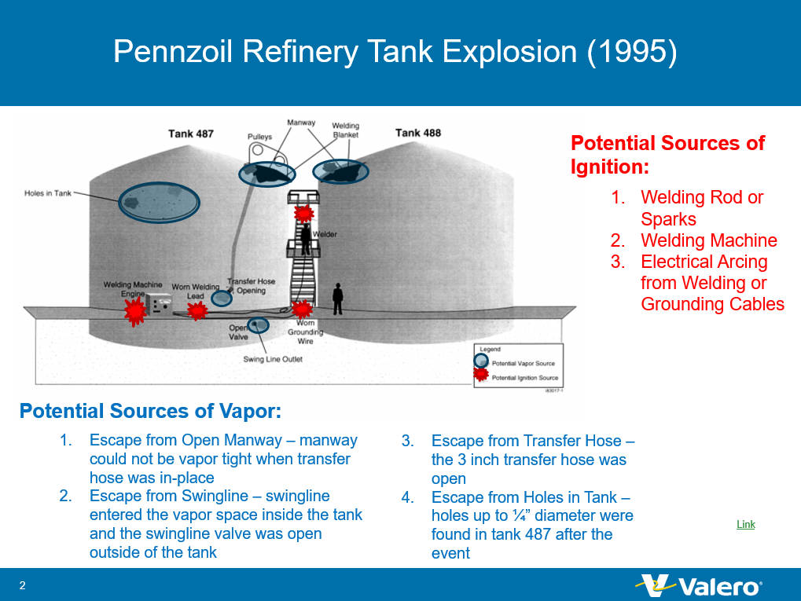
“Throwback Thursday” Example
Pennzoil Refinery Tank Explosion (1995)
Link

Slide 16


The Day the Regulator Clapped
September 19, 2019
50 Throwback Thursday video sharings

Slide 17
Improving Process Safety Management Performance
Strongest process safety culture ever assessed by a leading consulting firm
Eighteen months without an API 754 Tier 1 or Tier 2 process safety incident (previously averaged ~5 per year)
  Many great catches by engaged personnel
  Strong sense of vulnerability and desire to get better
Re-applied concepts in Pulp and Paper industry with great success!

Slide 18
Questions?
Chris Robinson
chris.robinson@nebulasafety.com
Subject Matter Expert
www.nebulasafety.com

